Slide 1
Sales Dashboard summary
Created Using Power BI
Presented by: Fauzia Jamal | Task 4 |

Slide 2
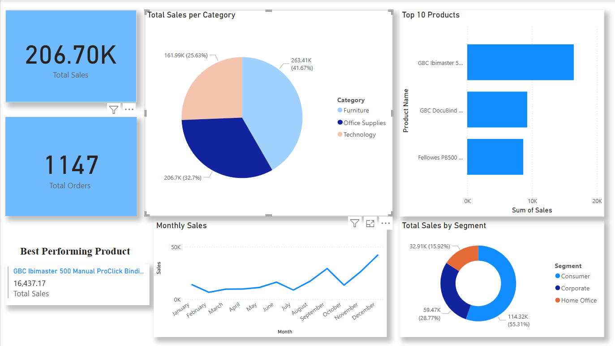
Project Overview
In this project, I created a sales dashboard using Power BI. The main purpose was to help people in the business quickly understand important sales information. The dashboard includes charts, graphs, and summary cards to clearly show sales performance over time, by product, category, and customer type.

Slide 3
Key KPIs & Highlights
The dashboard highlights two main results: Total Sales of 1.08 million and Total Orders of 4,922. The product with the highest sales is Canon imageCLASS 2200 Advanced Copier, which earned over 30,000 in sales. These numbers are shown in large, easy-to-read cards.

Slide 4
Insights from Visualizations
Sales are divided into three categories: Office Supplies (42%), Furniture (33%), and Technology (25%). A bar chart shows the Top 10 best-selling products. There is also a line chart showing monthly sales, which go up and down, with the highest sales happening in December.
Sales by Category:
Office Supplies: 41.67%
Furniture: 32.7%
Technology: 25.63%
Top 10 Products: Horizontal bar chart shows top contributors by sales value
Sales Trend: Steady growth with peak sales in December

Slide 5
Segment Performance
The dashboard also shows sales by customer segment. Consumers made the most purchases (51%), followed by Corporate and Home Office customers. The design is clean and simple, with clear colors and easy-to-read charts.
Sales by Segment:
Consumer: 51.03%
Corporate: 30.78%
Home Office: 18.19%
Interactive Features:
Slicers & filters
Clean layout with summary cards
Time-series and categorical analysis

